Slide 1


HEART DISEASE PREDICITION WEBSITE
MINOR PROJECT

Slide 2

TEAM MEMBERS
SKANDH VISHWAMBHAR (20103327)
PRATEEK MEHRA (20103304)
SPARSH MITTAL

Slide 3


INTRODUCTION
Heart disease is one of the leading causes of death worldwide and places a significant burden on individuals, families, and healthcare systems. Early identification and prevention of heart disease is critical to reducing its prevalence and improving patient outcomes. In recent years, advances in machine learning and data analysis have offered promising avenues for predicting heart disease and providing proactive interventions.
The Heart Disease Prediction Project aims to harness the power of data-driven models to increase the accuracy and efficiency of cardiovascular risk assessment. By leveraging the wealth of medical data available, including patient demographics, medical history, lifestyle factors, and diagnostic tests, we can develop a robust predictive system to help identify individuals at high risk of developing heart disease.

Slide 4
CONTI….
The primary goal of this project is to create a reliable and user-friendly tool that health care providers can use to estimate the likelihood that an individual will develop cardiac complications. By integrating advanced algorithms and predictive models, this system can assist medical professionals in making well-informed decisions regarding patient care, facilitating early intervention strategies and ultimately saving lives.
In addition, the Heart Disease Prediction Project emphasizes the importance of privacy and ethical considerations. We ensure that all patient information is handled securely and in compliance with applicable regulations, maintaining confidentiality and protecting sensitive data at all times.
Through this project, we aim to significantly impact the field of cardiovascular health by harnessing the potential of machine learning and data analysis. By accurately predicting heart disease risk, we aim to enable healthcare professionals and individuals to take proactive measures to prevent heart-related complications, leading to a healthier and more resilient population.
Let's embark together on this journey towards a future where early detection and preventive care play a key role in fighting heart disease and improving cardiovascular well-being.

Slide 5

PROBLEM STATEMENT
HEART ATTACK is a leading cause of mortality and morbidity worldwide, imposing a significant burden on individuals, families, and healthcare systems. Early detection and accurate prediction of heart disease risk is important for timely intervention and implementation of preventive measures. Traditional risk assessment methods based on individual risk factors have limitations in accurately predicting the likelihood of heart disease. Therefore, there is a need for a reliable and efficient predictive model that uses machine learning techniques to accurately identify individuals at high risk of developing heart disease.
Design and develop a machine learning-based predictive model that can accurately assess heart disease risk in individuals. The model should use relevant demographic, clinical and lifestyle factors as input features and use appropriate machine learning algorithms such as logistic regression to predict the probability of a cardiovascular event. The model should be able to handle different types of data, including numerical, categorical, and ordinal variables, and should be scalable to handle large datasets.

Slide 6

METHODOLGY
Data collection and preprocessing:
Identify and collect datasets containing characteristics associated with heart disease, such as age, gender, blood pressure, cholesterol levels, medical history, and lifestyle factors.
Clean the dataset by handling missing values, removing duplicates, and dealing with outliers.
Perform feature scaling or normalization to ensure that the variables are scaled equally.
To ensure compatibility with machine learning algorithms, encode categorical variables using techniques such as single encoding and label encoding.
Model selection:
We choose logistic regression as a predictive model for predicting heart disease because of its effectiveness in binary classification tasks and interpretability.
For comparison, consider other algorithms such as decision trees, random forests, and support vector machines.
Data sharing and training:
Evaluate the performance of the model by dividing the pre-processed data set into training and test sets.
Set aside a portion of the training data for validation purposes.
Train a logistic regression model using the training set and adjust hyperparameters as needed.
Validate your model using the validation set to ensure optimal performance.

Slide 7
CONTI….
Model evaluation and performance criteria:
Evaluate the trained logistic regression model using appropriate performance metrics such as accuracy, precision, recall, F1 score, and area under the ROC curve.
To assess effectiveness, compare your model's performance to a baseline or other established models.
Interpretation and expansion Deployment:
Analyze the coefficients of the logistic regression model to interpret the effect of each characteristic on the prediction of heart disease.
Apply trained models to predict heart disease risk from new or unseen data.
Create a user interface or application to allow users to enter information and obtain a personalized heart disease risk prediction.
By following this method, the project efficiently collects, preprocesses, and analyzes data, selects appropriate models, trains and evaluates model performance, interprets results, and conducts research to assess the risk of heart disease

Slide 8
FUNCTIONAL REQUIREMENTS
User Registration: Allows users to register on the Website to create a user account and access personalized heart disease risk predictions.
User Input: Provides an easy-to-use interface for users to enter demographic information, clinical variables (blood pressure, cholesterol levels, etc.) and lifestyle factors (smoking status, exercise habits, etc.).
Data Validation: Validate user input to ensure that entered data is correct and consistent.
Heart Disease Prediction: Uses a pre-trained logistic regression algorithm to process user input data and predict the likelihood of developing heart disease.
Predictor Output: Provides the user with predictions of heart disease, indicates the level of risk (low, moderate, high, etc.) and provides additional information or recommendations based on the predictions.
Risk Visualization: Provides visual predictions of heart disease risk using charts, graphs, or visual displays to enhance user understanding.
Personalized Recommendations: Provides personalized recommendations for lifestyle changes, preventative measures, and potential interventions based on your predicted risk level.
Privacy and Security: We implement appropriate security measures to protect user data, ensure confidentiality and comply with data protection regulations.
Feedback and Support: Provide a feedback mechanism or support system for users to report problems, make suggestions, or get help with website features and predictions.

Slide 9

NON FUNCTIONAL REQUIREMENTS
Performance: Ensure the website's responsiveness and efficiency, allowing users to obtain heart disease predictions quickly.
Scalability: Design the website to handle a growing number of users and accommodate increasing data volume.
Usability: Create an intuitive and user-friendly interface that is easy to navigate, minimizing user confusion or errors.
Reliability: Ensure the reliability and accuracy of the heart disease prediction algorithm, undergoing rigorous testing and validation.
Compatibility: Ensure compatibility across different web browsers, operating systems, and devices to provide access to a wide range of users.
Maintainability: Develop the website with clean and modular code, enabling easy maintenance and future updates.
Accessibility: Ensure the website is accessible to users with disabilities, adhering to accessibility guidelines and standards.
Ethical Considerations: Adhere to ethical guidelines for handling user data, ensuring transparency and user consent in data usage and privacy policies.
Performance Metrics: Define performance metrics, such as response time, prediction accuracy, and user satisfaction, to measure and monitor the website's performance.

Slide 10

ALGORTIHM USED
Logistic regression is a widely used machine learning algorithm for binary classification tasks. It is particularly suitable for predicting the probability of an event or class membership based on a set of input features. Here is an overview of how logistic regression works for prediction:
Model Representation:
Logistic regression models the relationship between the input features (X) and the probability of a binary outcome (y).
The output of the logistic regression model is a probability value between 0 and 1
Hypothesis Function:
The logistic regression hypothesis function applies a transformation to the linear combination of input features and model parameters (weights).
The hypothesis function uses the sigmoid function (also called the logistic function) to constrain the output between 0 and 1.
Training the Model:
The logistic regression model is trained by finding the optimal values of the parameter vector θ.
The training process aims to minimize the difference between the predicted probabilities and the actual binary labels.

Slide 11
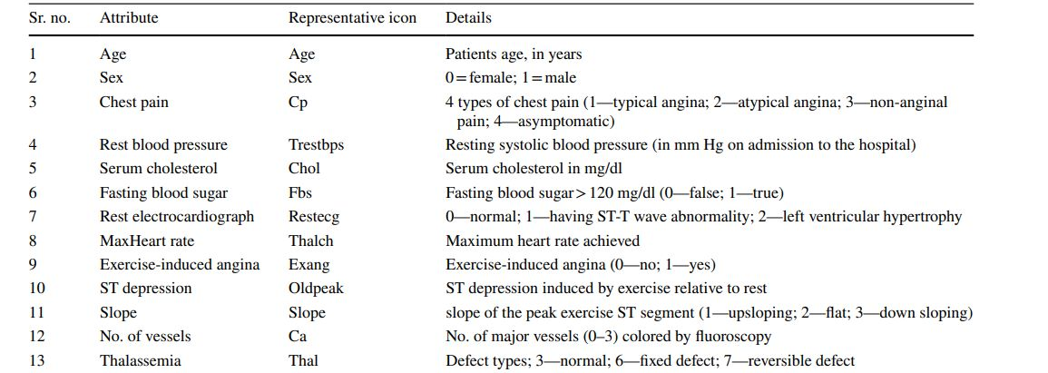
ATTRIBUTES

Slide 12
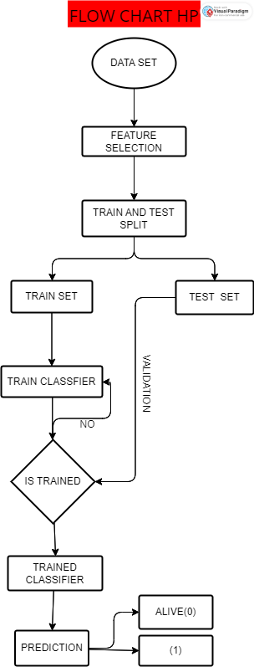

Slide 13
CONCLUSION
In conclusion, the heart disease prediction system using logistic regression is a valuable tool for identifying individuals at risk of developing heart disease. Logistic regression is a popular statistical technique used for binary classification problems, such as predicting the presence or absence of heart disease.
The system uses various risk factors, such as age, gender, cholesterol level, blood pressure, and smoking habits, to predict the likelihood of developing heart disease. By analyzing these risk factors, the system can provide accurate predictions about an individual's risk of developing heart disease.
The implementation of this system can help healthcare providers identify patients who are at a high risk of developing heart disease and provide appropriate interventions to prevent or manage the condition. Overall, the heart disease prediction system using logistic regression is a promising tool that has the potential to improve the quality of care and health outcomes for patients at risk of developing heart disease.

Slide 14




THANK YOU TEAM MINOR

